Slide 1
Mathesh P
Bachelor of Engineering
Computer science and engineering
211521104086
3/21/2024 Annual Review

Slide 2
PROJECT TITLE
Species Classification of wildlife using random forest
3/21/2024 Annual Review

Slide 3


AGENDA
Introduction
Project Overview
Implementation Details
Additional Processes
Demonstration
Conclusion & Discussion
3/21/2024 Annual Review

Slide 4

PROBLEM STATEMENT
Develop an analysis pipeline for zoo animal classification using ML. Conduct EDA to understand class distribution and feature prevalence. Explore feature importance and relationships with behavior. Evaluate model performance using accuracy, F1-score, precision, and recall for zoo population management insights.
3/21/2024 Annual Review

Slide 5

PROJECT OVERVIEW
This project analyses dataset aims to classify species into different types using logistic regression.\\\
Data Exploration:
Load and explore the dataset.
Check for missing values and class distribution.
Visualization:
Visualize class distribution and feature distributions.
Pre-processing:
Handle missing values.
Encode categorical variables.
Scale numerical features.
Model Building:
Split data.
Build a logistic regression model.
Evaluate using accuracy, precision, recall, F1-score.
Fine-tuning:
Tune model hyperparameters.
Explore other algorithms for comparison.
Conclusion:
Summarize findings and model performance.
Discuss limitations and future work.
3/21/2024 Annual Review

Slide 6

WHO ARE THE END USERS?
Data Scientists / Analysts: Professionals who analyse and interpret complex data sets to inform business decisions or research findings. They would use this code to explore and visualize patterns, distributions, and relationships within the data, as well as to preproccess data for further analysis.
Machine Learning Engineers: Engineers responsible for designing, implementing, and deploying machine learning models. They would utilize this code to preproccess data, visualize class distributions, and potentially train and evaluate machine learning models on the dataset.
Researchers: Scientists or academics in fields such as biology, ecology, or zoology who study animal classifications and characteristics. They would employ this code to analyse and visualize zoo-related datasets, enabling them to identify trends or patterns in animal classifications or behaviours.
Students / Learners: Individuals learning about data analysis, machine learning, or related fields who seek practical examples and hands-on experience. They would study this code to understand common data analysis techniques, data visualization methods, and best practices in Python programming.
3/21/2024 Annual Review

Slide 7

YOUR SOLUTION AND ITS VALUE PROPOSITION
Reading Data:
Solution: Read the CSV file once with the correct path.
Data Concatenation:
Solution: Ensure you have distinct datasets to concatenate or remove the concatenation step.
Data Exploration and Visualization:
Solution: Ensure clarity in visualizations, label axes appropriately, handle missing values, and provide meaningful titles.
Modelling:
Solution: Utilize imported libraries to build a classification model, predicting the class type of zoo animals based on features.
Value Proposition:
Gain insights into class distribution and feature relationships for informed zoo management.
Automate class prediction for categorization and management purposes.
Improvements:
Properly handle missing values, outliers, and data preprocessing.
Evaluate multiple classification algorithms and perform feature engineering.
Implement cross-validation and visualize model results for better interpretation.
3/21/2024 Annual Review

Slide 8

THE WOW IN YOUR SOLUTION
Variable Naming: Ensure consistent and descriptive variable naming. For example, df and df2 could have more meaningful names like zoo_data1 and zoo_data2.
Plot Titles: Add titles to your plots using plt.title() to provide context and improve clarity.
Visualization Customization: Experiment with customizing your visualizations further by adjusting parameters like colour palettes, plot sizes, and font sizes.
Data Cleaning: Check for and handle any missing or erroneous data appropriately before proceeding with analysis.
Data Sampling: Consider randomly sampling a subset of your data for faster analysis and visualization, especially if dealing with large datasets.
3/21/2024 Annual Review

Slide 9
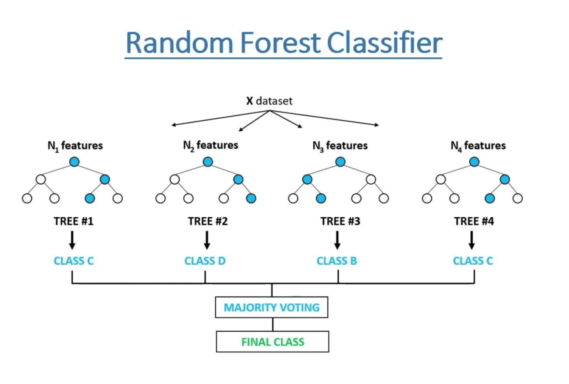
MODELLING

Slide 10
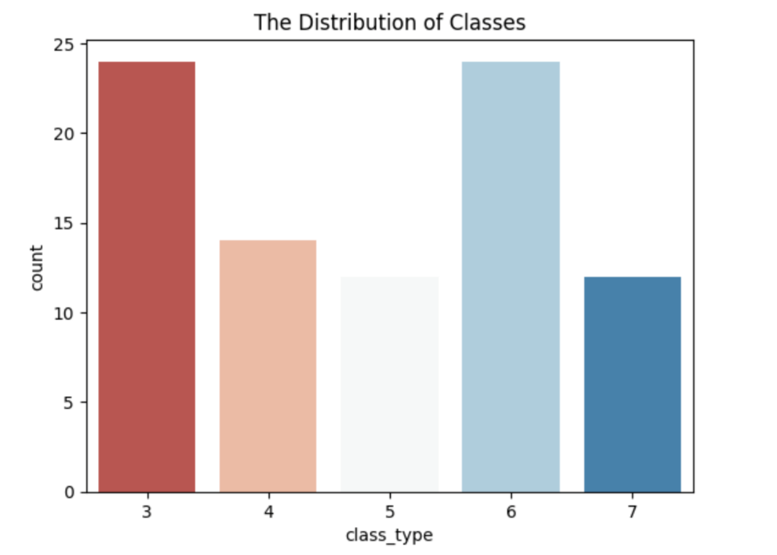
RESULTS
print(df3['class_type'].value_counts())
sns.countplot(data = df3, x = "class_type", palette = "RdBu")
plt.title("The Distribution of Classes")

